Slide 1
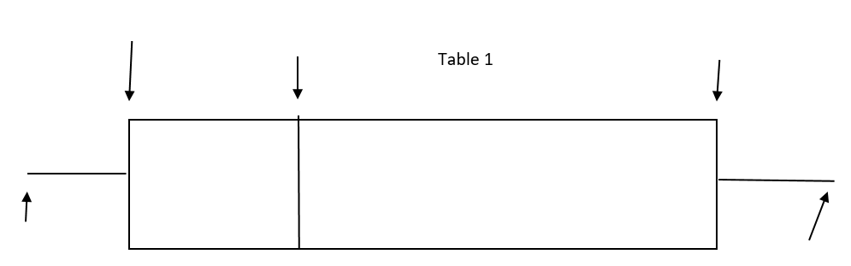
A Box Plot separates data into four sections: 2 parts in the box and one part on both ends of the box.
Each section represents 25% of the data.
The entire “box” represents 50% of the data.

Slide 2
Some terminology
Positive skew: median closer to LQ than UQ
Negative skew: median closer to UQ than LQ
Symmetrical distribution

Slide 3
FILM A
FILM B
FILM C
Age of film viewer
What can you tell about these films from this box plot?
Could you work out the genre of these films?
Compare the box plots and write down anything you notice
Notes:
B

Slide 4
FILM A
FILM B
FILM C
Which of the films do you think you would not be allowed to legally watch at the cinema?
Film A
Film B
A
B
Film C
Cannot tell
C
D
Notes:
B

Slide 5
FILM A
FILM B
FILM C
How can we tell that the film you would not be allowed to see is film C?
The minimum value
The lower quartile
A
B
The upper quartile
The maximum value
C
D
Notes:
B

Slide 6
FILM A
FILM B
FILM C
Which of the films do you think you would enjoy the most?
Film A
Film B
A
B
Film C
Cannot tell
C
D
Notes:
B

Slide 7
FILM A
FILM B
FILM C
What percentage of film B’s audience were between 15 and 30 (the box)?
25%
50%
A
B
75%
Cannot tell
C
D
Notes:
B

Slide 8
FILM A
FILM B
FILM C
What film would your parents probably enjoy most?
Film A
Film B
A
B
Film C
Can’t tell
C
D
Notes:
B

Slide 9
FILM A
FILM B
FILM C
Which of the following are reasons for why your parents would probably prefer film A?
Only 25% of the audience was less than 34
The range is bigger
A
B
It had the greatest maximum age
The median is greater
C
D
Notes:
B

Slide 10
FILM A
FILM B
FILM C
Now we have analysed these box and whisker plots
Can you guess what genre of film each box plot might represent? Can you work out the target audience of each film?
Justify your decision using mathematical language
Notes:
B

Slide 11
Film A
Genre - historical/political/crime
Target audience – 35 to 50 years old
Mathematical justification
  The most representative 50% of the audience were between approximately 35 and 50 years old.
  The lower quartile was approximately 35 years old.
  The upper quartile was approximately 50 years
old.
  Only 25% of the audience were less than approximately 35 years old

Slide 12
Film B
Genre - comedy
Target audience – teenagers and people in their twenties
Mathematical justification
  75% of the sample were less than 30 (upper quartile was 30)
  The lower quartile and median were very close together (25% of the sample were between approximately 15 and 17)
  50% of the audience were between 15 and 30 (lower quartile = 15, upper quartile = 30)

Slide 13
Film C
Genre - horror
Target audience – people between 18 and 35
Mathematical justification
  The minimum value was 18 (suggesting it had an 18 certificate)
  The maximum value was 40 (suggesting older people did not want to see this film)
  The range of this film was small
  25% of the audience were between 22 and 25 (lower quartile = 22, median = 25)

Slide 14
Boys
Girls
Write down three comparisons between the weight of boys and girls that are shown in this box plot
Notes:
B

Slide 15
Boys
Girls
Which of these comparisons are correct?
Boys weigh more than girls on average
The lightest girl is lighter than the lightest boy
A
B
The heaviest boy is the same weight as the heaviest girl
Girls weight is less consistent than boys
C
D
Notes:
B

Slide 16
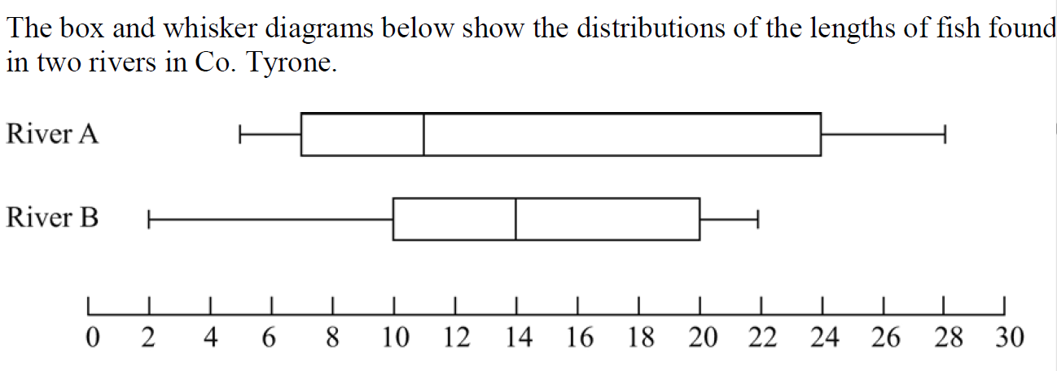

Slide 17
In which river are the lengths of the fish on average longer?
River B because the lower quartile is bigger
River B as the median is bigger
A
B
River A because the upper quartile is bigger
River A because the maximum value is bigger
C
D
Notes:
B

Slide 18
In which river are the lengths of the fish more variable?
River B as the lower quartile is bigger
River B because the lower quartile is bigger
A
B
River A because the upper quartile is bigger
River A because the IQR is bigger
C
D
Notes:
B

Slide 19
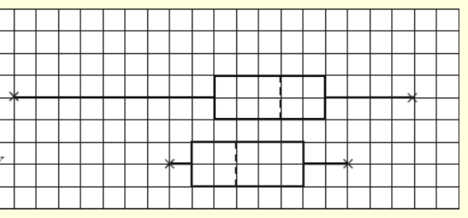
Red Bricks
Yellow Bricks
Box plot showing strength of bricks.
The builder might prefer to use red bricks because…
The range is bigger for red bricks
The median for red bricks is higher
A
B
The minimum value is less for red bricks
The IQR is less for red bricks
C
D
Notes:
B

Slide 20
Red Bricks
Yellow Bricks
Box plot showing strength of bricks.
The builder might prefer to use yellow bricks because…
The minimum value is smaller
The median is smaller
A
B
The maximum value is smaller
The range is smaller (more consistent)
C
D
Notes:
B

Slide 21
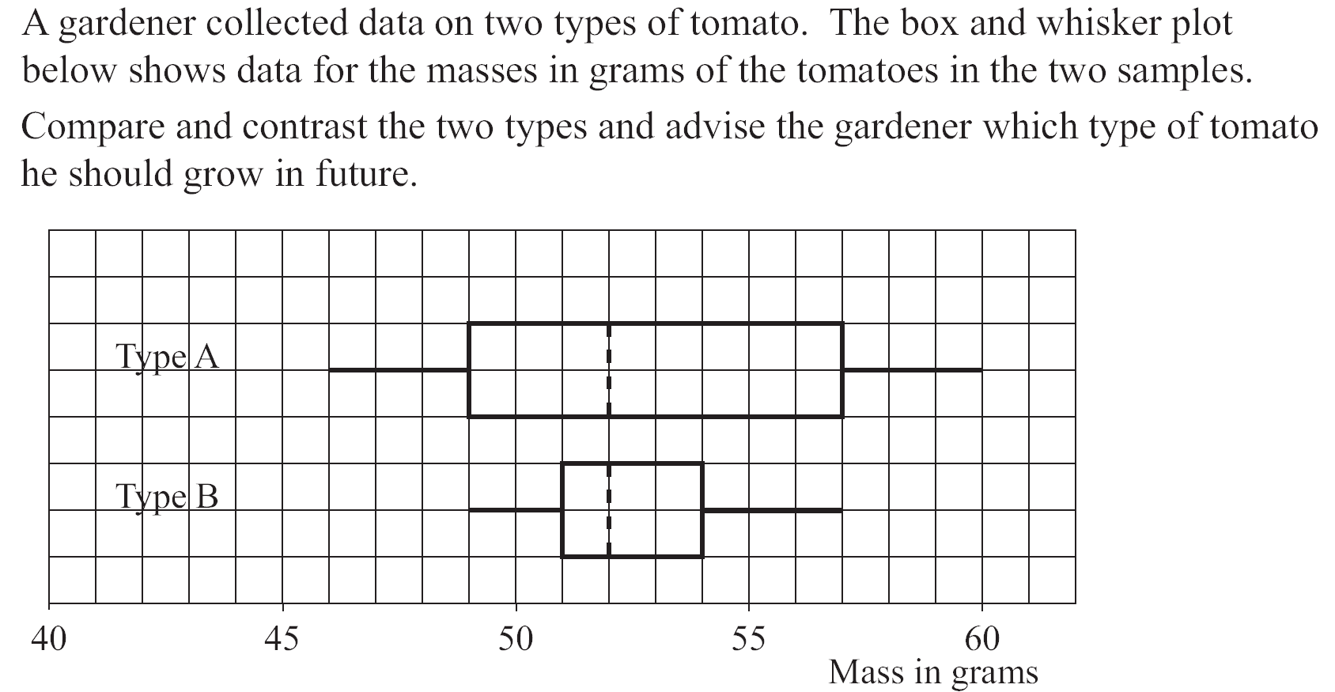
Box and whisker plots

Slide 22
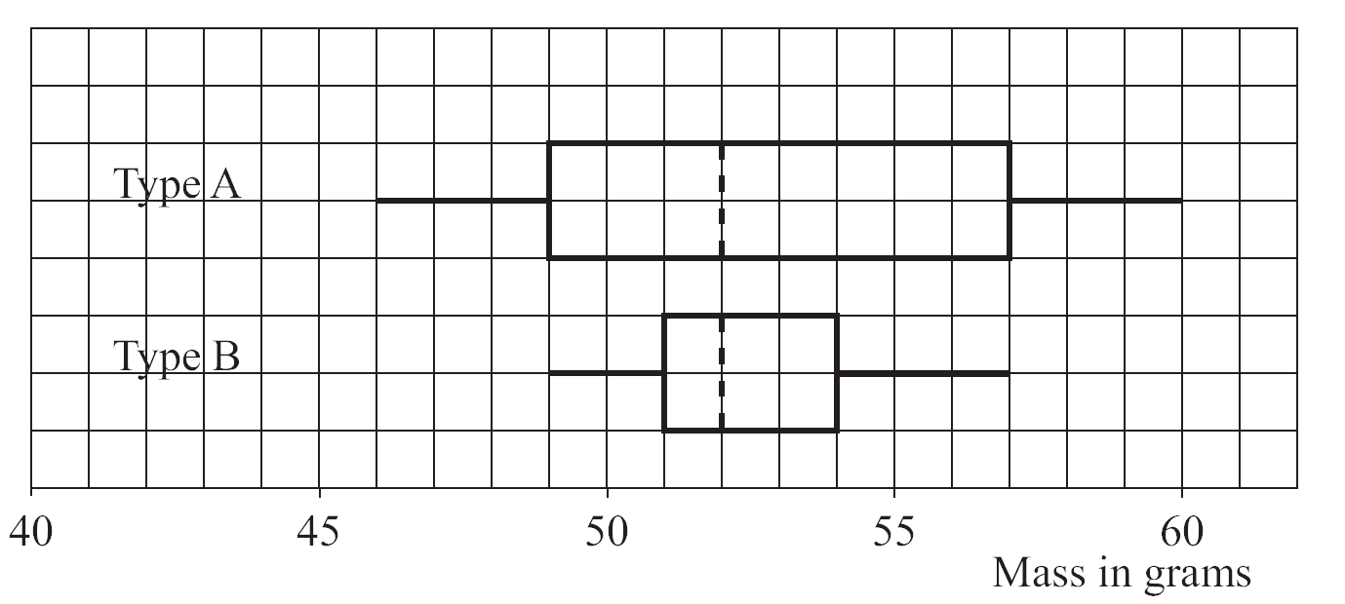
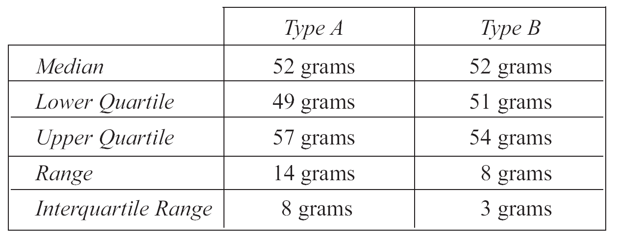

Slide 23
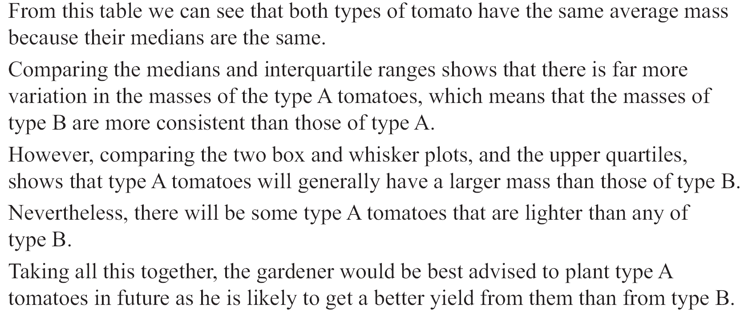

Slide 24
